Slide 1

Personal Investment Management System
Catherine Christina Ganduri-CCG220000
Hrushikesh Sriramaneni - HXS220013
Koushik Gadpale -KXG220036
Rachana Gaddam- RXG220036
Yamini Avula-YXA220018

Slide 2
Overview
Budgeting, saving, and spending money over time while taking into account different financial risks is Personal Investment(Single or Family)
Investment management - Collection of financial assets(independently or with an investment manager's help)
purchasing and selling assets,
creating short- or long-term investment strategies
overseeing a portfolio's asset allocation
developing a tax strategy
Investment portfolio- Not just about handling specific assets in a portfolio. It’s more than that!
Risk tolerance
financial priorities
investment management

Slide 3
Objective
To create a personal investment management system with the following capabilities:
Portfolio Management
Investment Analysis
Asset Performance Measure
Data driven decision making

Slide 4
Designing Investment Management System
Database is developed using MySQL by the following steps
1.Designing Relational Schema
2.Creation of Database, Tables, Structures, Data Types and Formats
3.Creation of Queries
4.Creation of Stored procedures, functions and triggers corresponding to the distinct requirements

Slide 5
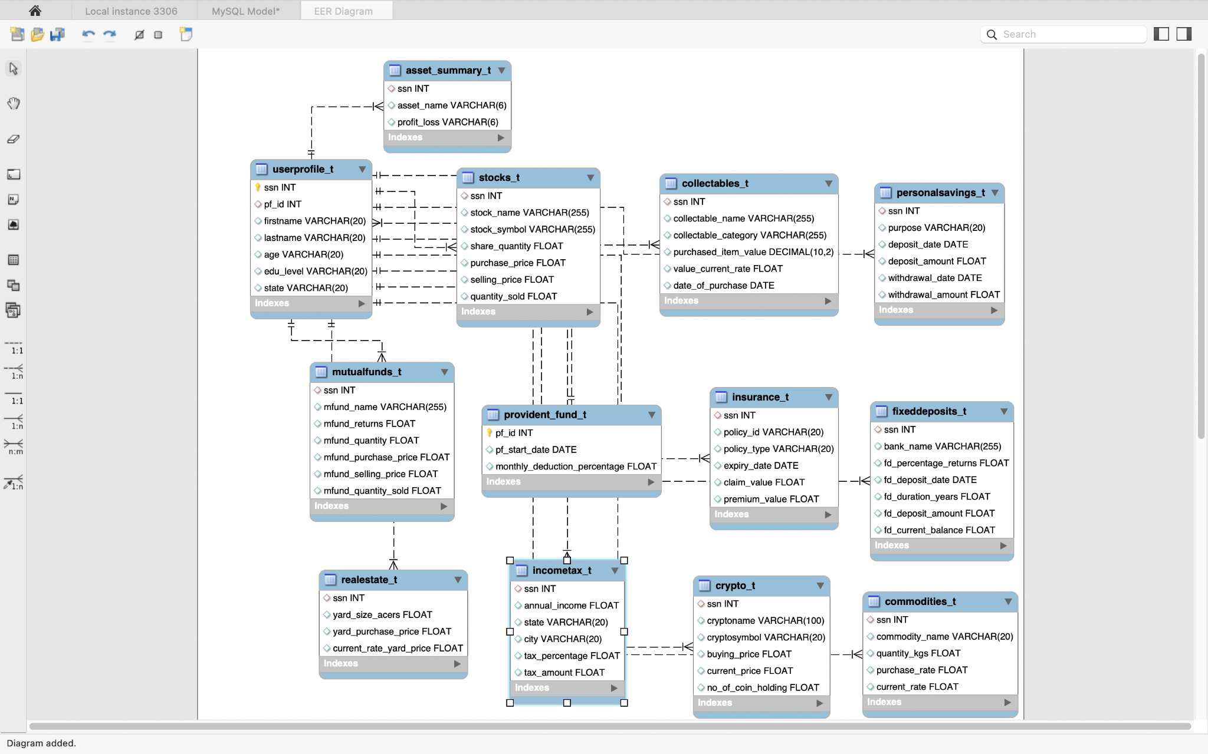
Relational Schema – ER Diagram

Slide 6
Tables
This database consists of a total of 13 tables which includes the following asset categories
Stocks
Crypto
Mutual funds
Collectables
Provident fund
Insurance
Fixed Deposits
Personal Savings
Real Estate
Commodities

Slide 7
Queries
JOINS :
By using join performed profit/Loss for three asset categories Real estate, Mutual funds, and stocks for 4 users.
Calculated total profit for each user across all his crypto holdings by joining the user profile and Crypto table.
SubQuery :
We used a subquery to obtain the personal savings of each individual who pays income tax of more than 4%.

Slide 8
Queries
View:
Created a view to find out the users who have cars in their collectables.
Union:
Obtained the user who has profit more than a million from either crypto or stocks.
Aggregate functions:
Found out users who pay total premium more than $1000 and total claim less than $50000.

Slide 9
Stored Procedures and Functions
Using get_profit stored procedure we obtained profits across all the asset categories for a given user.
Call procedure get_profit(ssn)
Using mfund_assetperformace stored procedure we categorize a users asset into Low, Average and High performing investments based on a function categorize_assets( ).
Call procedure mfund_assetperformance(ssn).
Using crypto_calculator stored function we can get the total investment for each user in his crypto portfolio

Slide 10
Triggers
Creating a trigger and using BEFORE DELETE on the user_profiles_t table for getting access to the older customers.
Creating a trigger and using AFTER UPDATE on the stocks_t table for getting to know the change history and updating the related records in stocks
Created a trigger named incometax_audit using BEFORE UPDATE on the incometax_t table to get access to the old income data for users.

Slide 11


